Slide 1
ADVANCED DATA ANALYSIS BY MATHEMATICAL GNOSTICS Pavel Kovanic PRESented on June 21, 2016 at the 16th International Conference, IPMU 2016 Eindhoven, The Netherlands Full TEXT IN PROCEEDINGS IPMU 2016, Communications in Computer and Information Science 610, SPRINGER V.

Slide 2
MATHEMATICAL GNOSTICS
Mathematical Gnostics (MG) is an alternative paradigm of data uncertainty consisting of:
an axiomatic theory of strongly uncertain individual data and small samples supported by the laws of physics,
algorithms based on the ``Gnostic’’ theory,
applications of the ``Gnostic’’ algorithms.
Developed at the Institute of Information Theory and Automation of the Czechoslovak Academy of Sciences, Prague.
First publication: 1982.
The main problem facing Mathematical Gnostics:
the general aversion to a change of paradigm.
More on www.math-gnostics.com.

Slide 3
THE GIST AND MAIN RESULTS OF MG
Uncertain data are elements of two bi-algebras, the spaces of which are endowed by two metrics, one Minkowskian and one Euclidean.
Each data item has a couple of mutually interdependent characteristics of uncertainty, the error (“irrelevance’’) and weight (entropy), measurable by Riemannian geometry.
The space of uncertain data is curved by the impact of uncertainty, which is the cause of the problems of linear-quadratic estimating methods with robustness.
The curvature can be both convex and concave, giving rise to two kinds of robustness – with respect to outliers and inliers.
The activity of Maxwell’s demon (converting the information to an entropy increase) is described as an equation of a source of entropy field of the pre-statistical (Clausius’) kind, balancing the source of the field of information of an individual data item, which is formally identical to Shannon’s formula.
The formula of the parameter (p) of the information is recognized as the probability distribution of the individual data item and its derivative (probability density) as the Gnostic Kernel.
The virtual path of the estimation process compensating the entropy increase of quantification is shown to be the optimum, maximizing the information of the estimate.
The closed paths of quantification and estimation form an Ideal Gnostic Cycle, which is irreversible, like the real thermodynamic cycle.
The data aggregation principle is supported by relativistic physics.
3

Slide 5
VIEWING OUR WORLD - COMMENT
Limits of Mediocristan’s domain:
The left hand bound: Sample’s size at least about 30 data
The right hand bound: Data’s STD/Mean not exceeding about 1.03
Ordinarystan is based on gnostic theory of individual data applicable even to 1 data item and to heavy data uncertainty because of objectively estimated curvature of data space.
Moreover: The basic Gnostic characteristics of uncertainty converge to the statistical ones in cases of sufficiently weak data uncertainty. This makes the approach of Mathematical Gnostics a more general conception of uncertainty, which includes the statistical ones as a special case

Slide 6
GNOSTIC PROBABILITY DISTRIBUTIONS
There are two kinds of kernel estimates of probability and density distributions:
1) Local (ELDF) – which applies to a detailed insight into the data structure, to marginal analysis, and to data interval classification.
2) Global (EGDF) - which applies to the robust homogeneity test, identification of outliers, estimation of the bounds of data support, robust hypotheses testing and the estimation of censored data.

Slide 7
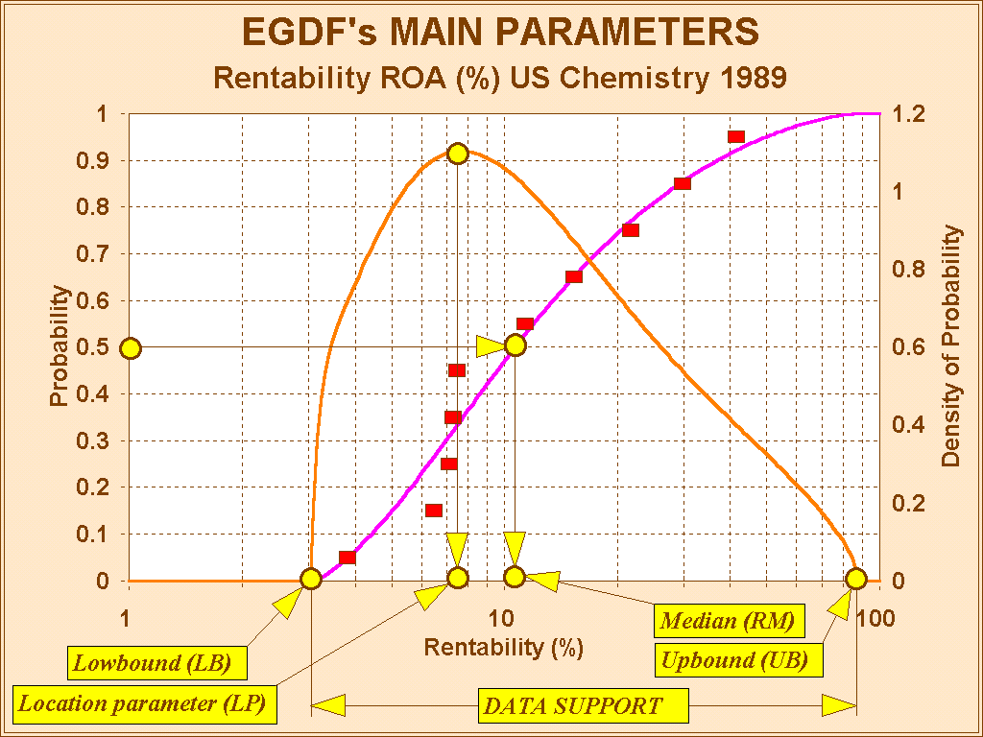
EGDF’s main parameters

Slide 8
PROBLEM: ACCUMULATION OF POPS IN PEOPLE LIVING NEAR A CHEMICAL PLANT
(POPS: PERSISTENT ORGANIC POLUTANTS)
The survey was performed in 2003 by a team of the National Institute of Public Health, Prague and the Faculty of Medicine, Charles University, Prague.
Statistical analysis:
Černá, M. et al., Levels of PCDDs, PCDFs and PCBs in blood of…, Chemosphere (2007), doi:10.1016/j.chemosphere.2006.05.104
Gnostic analysis:
Kovanic, P. and Ocelka, T., Loading of POPs in Czech people, workshop of the 2-FUN project EU, Institute of Public Health,Ostrava (2011)

Slide 9
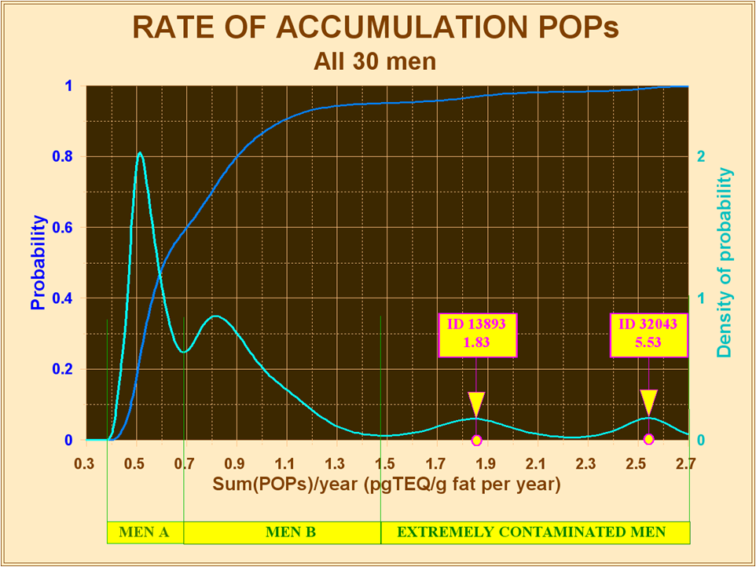

Slide 10
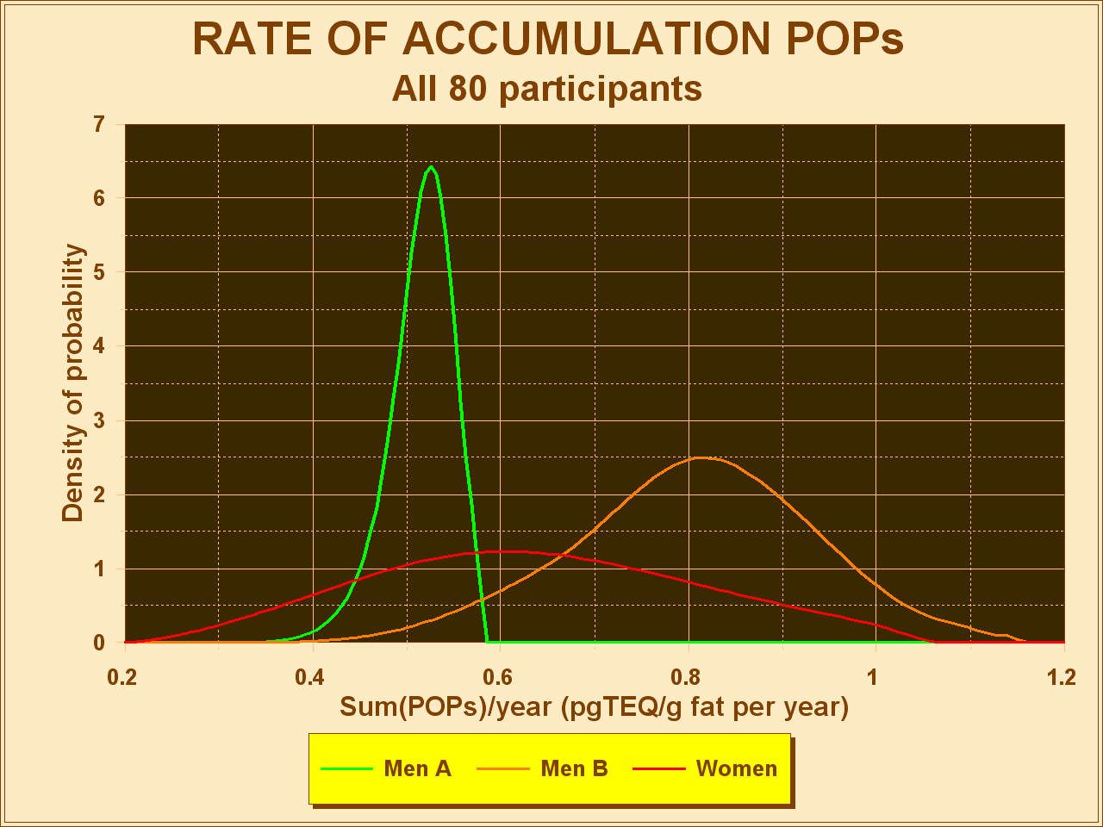

Slide 11
PROBLEM: MEDICAL DIAGNOSTICS BY MEANS OF REFERENCE VALUES
Reference values: RI: (LRV, URV)
Diagnosis: Are you in RI or out of RI?
Difficulties in estimating the RI:
a large number of participants to probe,
ensuring their homogeneity,
multitude of impacting factors.
Example: Estradiol in postmenopausal women
(data: prof. Žofková, Endocrinological Institute,
Prague)

Slide 13
ARE THE OFFICIAL DATA RELIABLE ?
Example: The data base of NIST (The National Institute of Standards and Technology USA)
Data set CAS 110-56-5 (Normal boiling temperature of 1,4-dichlorobutane)
12 data items, NIST summary is 410 ± 80
Homogeneity test: 2 data items are outliers
Summary of the remaining 10 data: 429.7 ± 0.7
Another example: chloroform

Slide 14
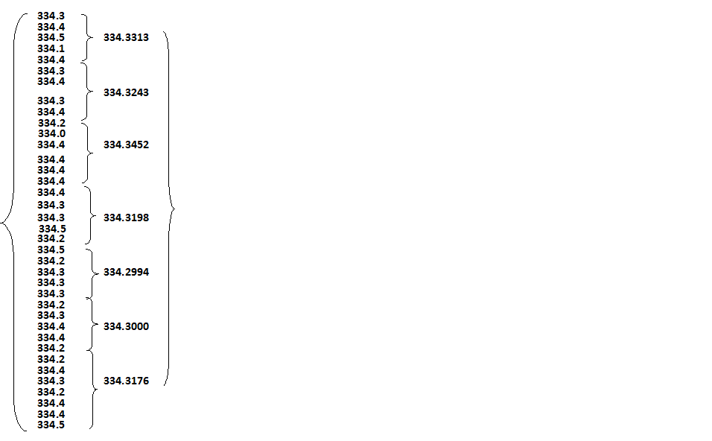
Boiling temperature of chloroform
ROBUST
SUMMARY
MG:
SUMMARY
NIST:
334.3
± 0.2
334.32
± 0.02
Conclusions:
Improved estimate
Five data suffice

Slide 15
AUTOMATIC DATA EXPLORATION
Example: again NIST data CAS 110-56-5
Diagnosis (“what data say about themselves”)
Additivity FALSE
Homogeneity FALSE
Outliers 308.15 and 322.00
Recom.metric Concave
Homoscedascity FALSE
DetrendEffect 0.05%
Curvature Effect 2.4%
Neighborcorr. 0,02
Information 0.76
Probability domain [426.2, 435.7]
Bounds of 8 classification intervals

Slide 16
ROBUST MULTIDIMENSIONAL PREDICTION
Prediction task: will the market rise or fall?
Data: financial ratios, Chemical Industry USA
The method: IWLS (Iterated Weighted Least Squares, alias Influence Function Method)
Comparison:
11 methods of robust statistics
Gnostic IWLS published in 1986
Effect of the successive elimination of the worst data

Slide 17
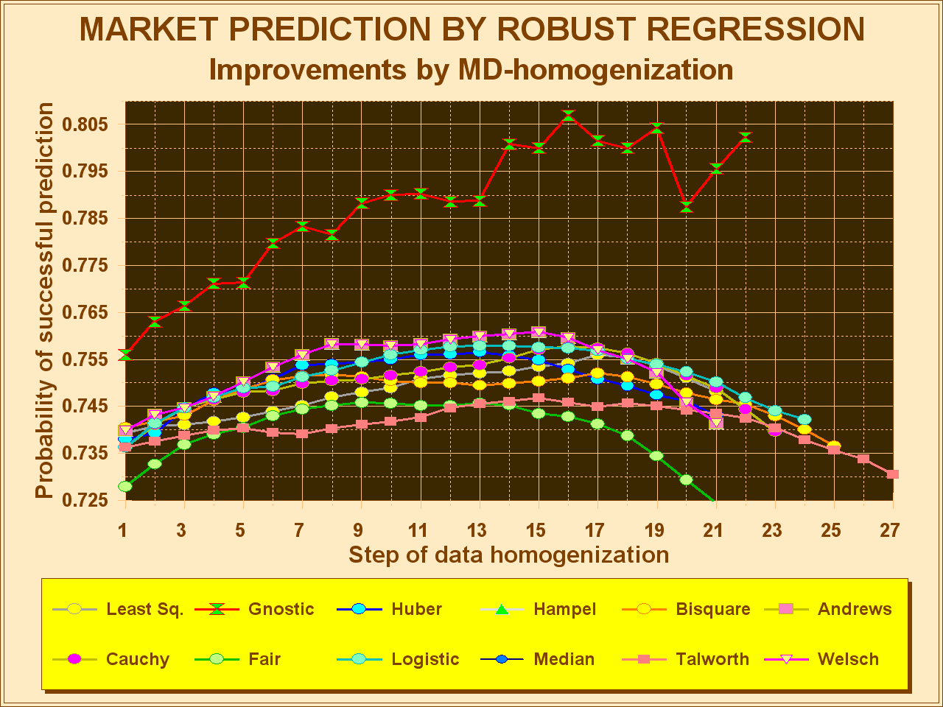

Slide 18
… thank you for your attention!
For any further information – do not hesitate contacting us….. www.math-gnostics.eu
Gnostic

